Slide 1

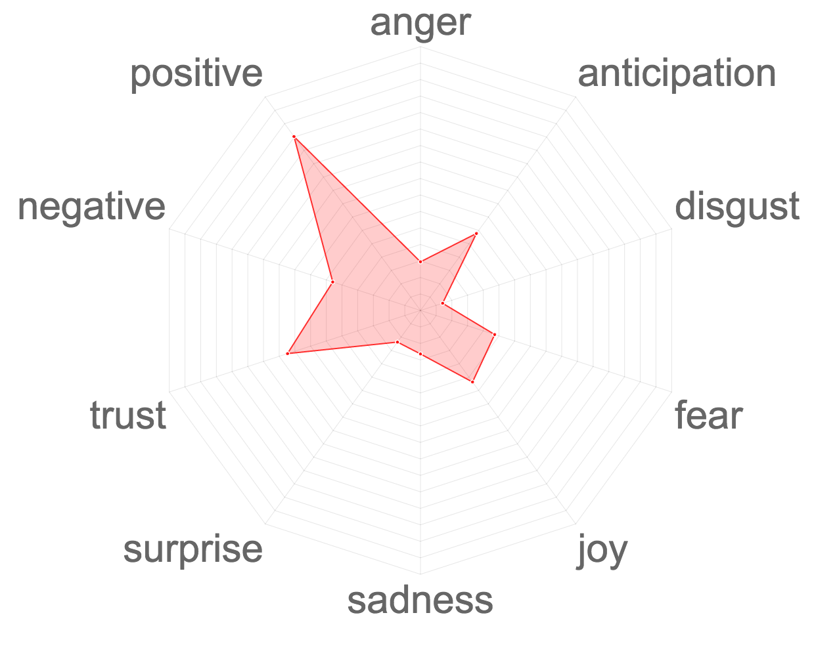
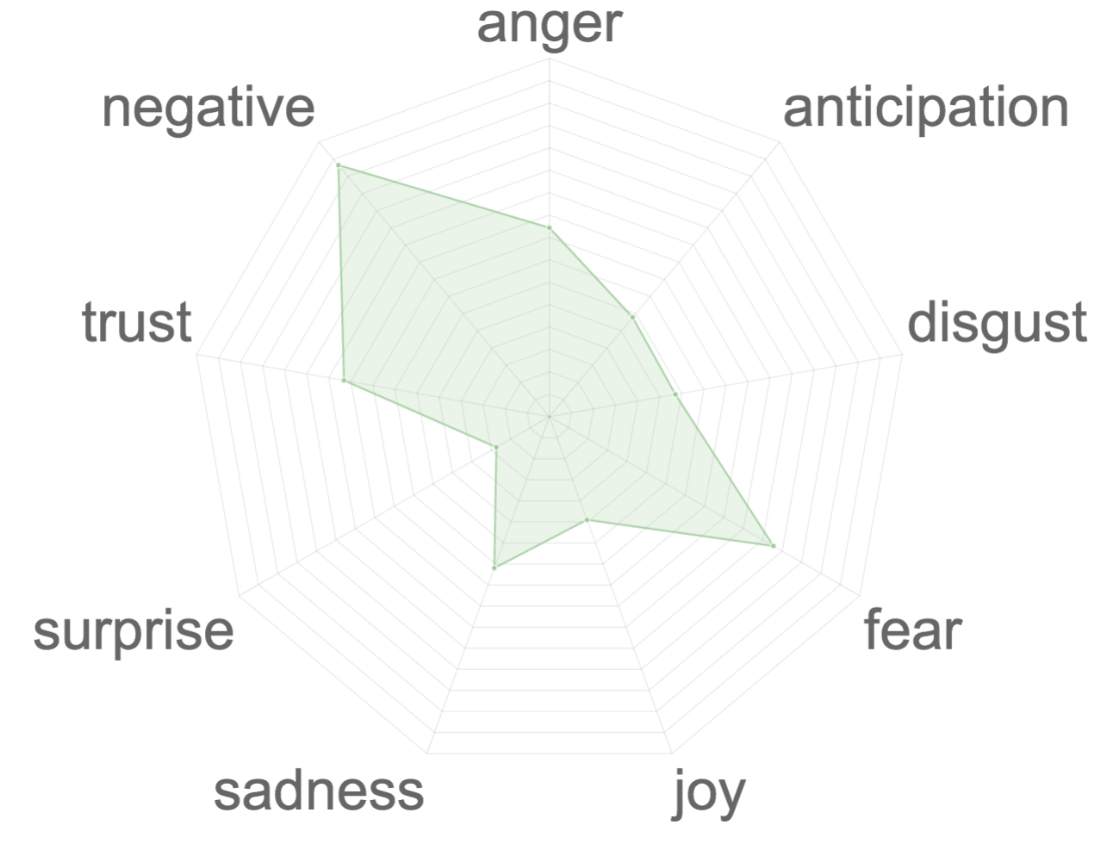
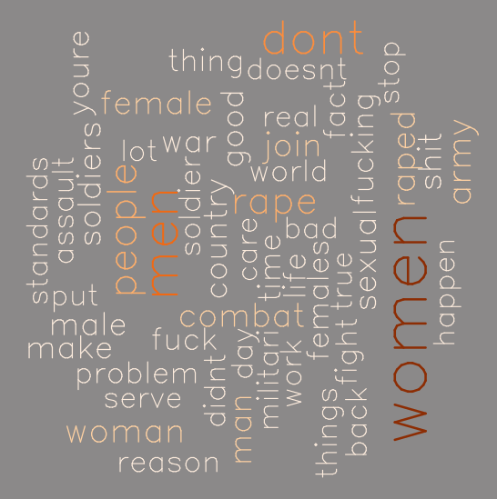
Department of Defense: Social Media and Policy
Mark Almanza, Maddie Arnsbarger, Jessica Flynn, Millicent Grant, Gizem Korkmaz, Will Sandholtz, Emily Stark, Katie Ziemer
Data Science for Public Good
Individuals at Fort … of the Department of Defense are interested in retention and attrition rates of army soldiers, and they wonder if information pertaining to these ideas could be discovered by analyzing data from social media outlets. Specifically, they asked
how does the US Army population use social media?
are there differences across groups?
are there differences across social media venues?
can we identify determinants of attrition from social media?
can we detect policy changes through the chatter on social media?
can we identify the sentiments for the policies?
Processing Steps:
Identify search terms
Determine what is possible and the limitations of each social media platform
Obtain data based on search criteria
  Twitter: tweets of users
  Facebook: posts of specific pages
  YouTube: comments on videos
Use text mining and other methods to analyze the data
Sentiment analysis shows that across the ten videos comments users express negativity and fear.
Word cloud of YouTube comments from ten videos related to sexual abuse and women in the Army.
References

